Slide 1
Modelling Colombian Economy: Stock-Flow Consistent Prototype Growth Model
An adaptation from Yilmaz & Godin (2020).

Slide 2
Structure of the presentation.
Changes made to the model
Changes not include into the code.
Baseline scenario.
Sensitivity analysis.

Slide 3
Changes made to the model.
Households loans demand.
Accelerator effect into the investment equation.
Central Bank does not purchase government bonds.
Feedback between labour productivity and public investment.
Government monetary transfers linked to a share of total population.
More detailed tax structure: consumption tax and royalties (proxy)
Autonomous exports.
Foreign Direct Investment
Further modifications to the external sector dynamics

Slide 4
Changes not include into the code.
Households loans demand. (desired credit demand)
Foreign Direct Investment
Capital utilization rate

Slide 5
Baseline scenario.
World GDP growths: 3%
Inflation rate: 4,6%
Exogenous capital flows: 0,005
Arbitrage parameter sensibility for capital flows and FX loans of the firms: 1
Exogenous cross border lending: 0,6

Slide 6
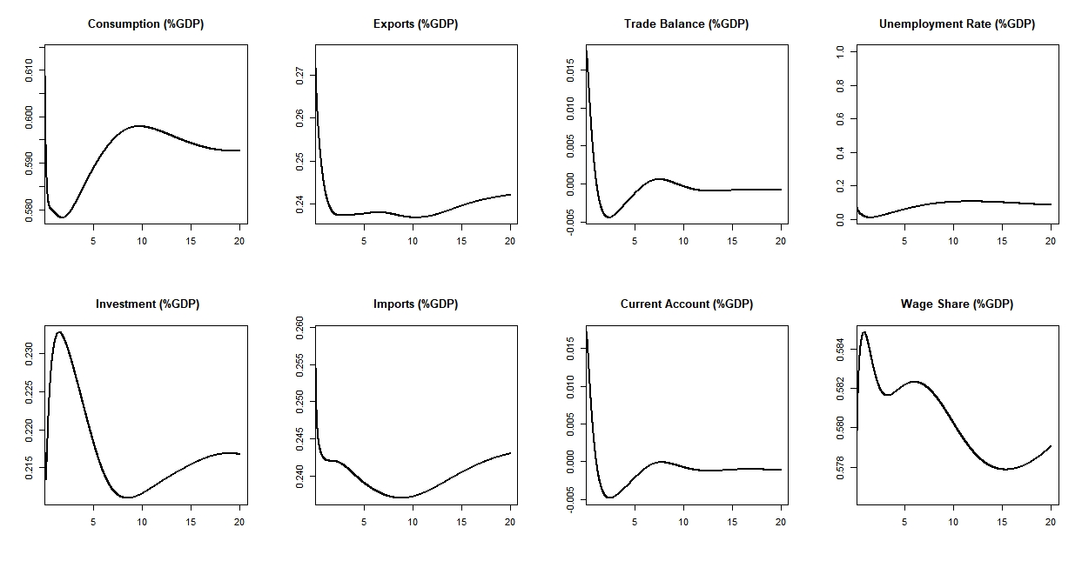
Baseline scenario

Slide 7
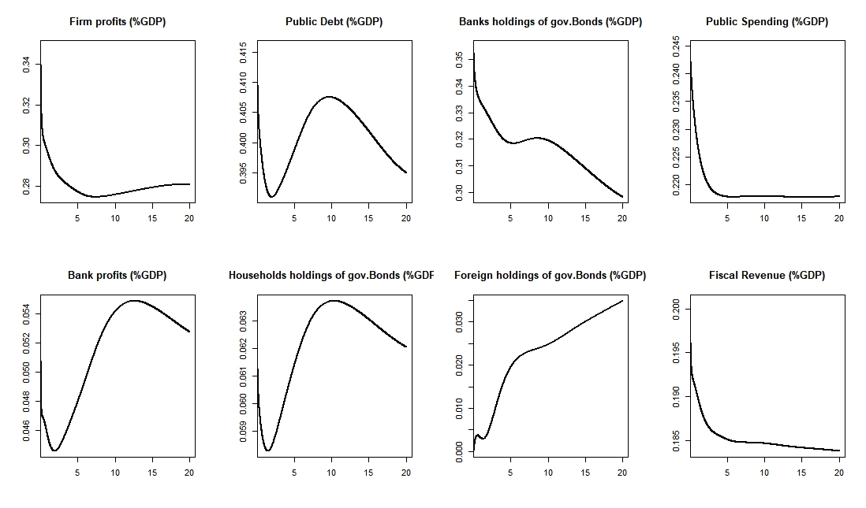
Baseline scenario

Slide 8
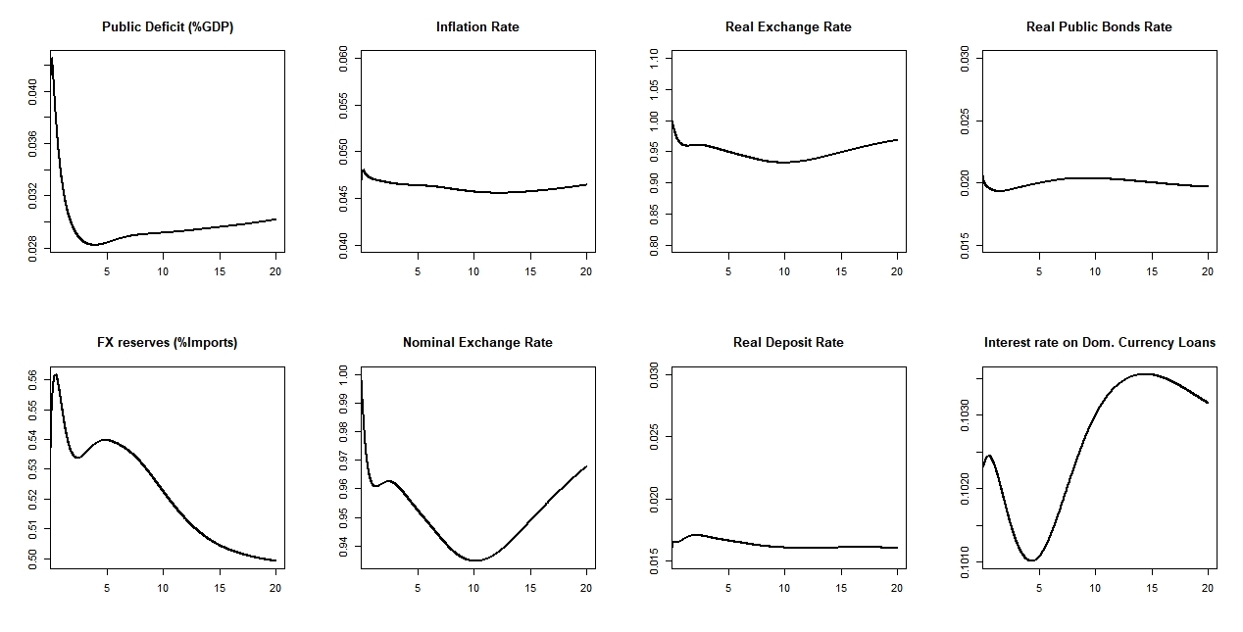
Baseline scenario

Slide 9
Sensitivity analysis.
 | Baseline scenario | Positive scenario | Negative Scenario
World GDP growths | 3% | 4,5% | 1,5%
Inflation rate | 4,6% | 5,5% | 3,5%
Exogenous capital flows | 0,005 | 0,01 | 0,0025
Arbitrage parameter sensibility | 1 | 2 | 0,75
Exogenous cross border lending | 0,6 | 0,8 | 0,5

Slide 10
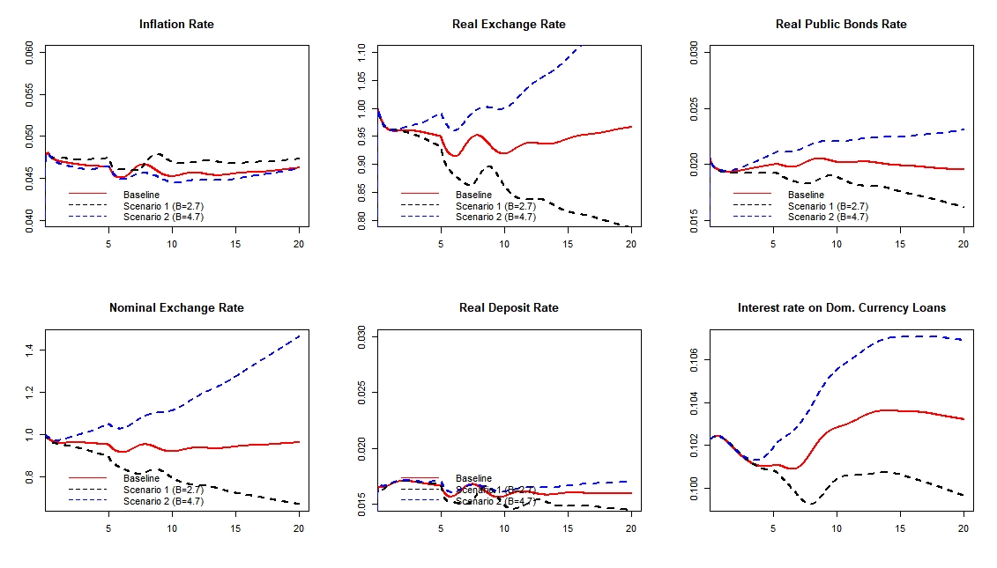
Sensitivity analysis.

Slide 11
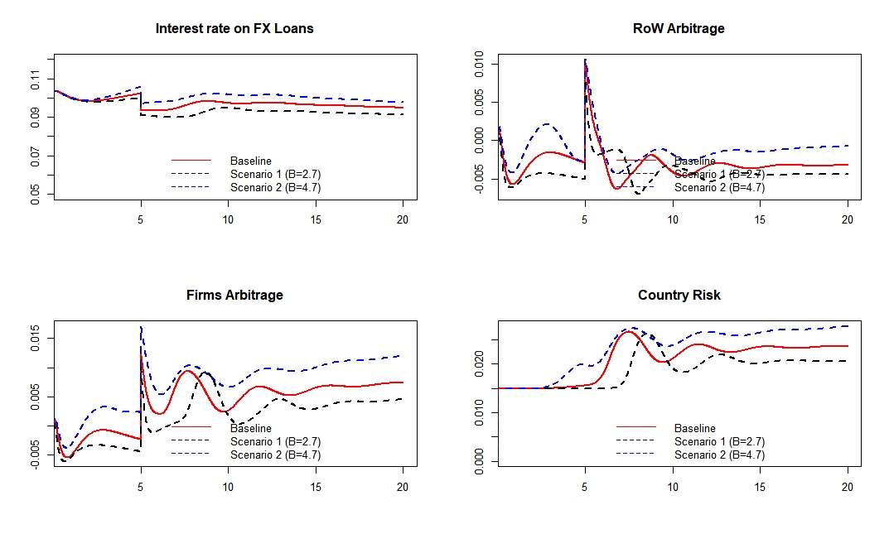
Sensitivity analysis

